Slide 1


Dplyr & Tidyr
CSCI 444

Slide 2


Pipe operator implemented in magrittr package
Pronounce as AND THEN
Shortcut: ctrl – shift – m
cmd – shift – m

Slide 3


Pipe Operator
What is %>%
  This %>%
  That %>%
  One_More_Thing %>%
  Finished
Without %>%
  park(drive(start_car(find("keys")),
  to = "campus"))
With %>%
  find("keys") %>%
  start_car() %>%
  drive(to = "campus") %>%
  park()
data <- c(1, 3, 5, 6, 11, 13, 17)
Without %>%
  mean(data)
  diff(data)
  mean(diff(data))
With %>%
  data %>%
  mean()
  data %>%
  diff()
  data %>%
  diff() %>%
  mean() %>%
  View()

Slide 4


Assignment Pipe
%<>%
myiris <- iris
myiris %<>% select(Species == “setosa”) %>%
print()

Slide 5
Glimpse Function
glimpse(french_fries)
  Observations: 696
  Variables: 9
  $ time <fct> 1, 1, 1, 1, 1, 1, 1, 1, 1, 1, 1, 1...
  $ treatment <fct> 1, 1, 1, 1, 1, 1, 1, 1, 1, 1, 1, 1...
  $ subject <fct> 3, 3, 10, 10, 15, 15, 16, 16, 19, ...
  $ rep <dbl> 1, 2, 1, 2, 1, 2, 1, 2, 1, 2, 1, 2...
  $ potato <dbl> 2.9, 14.0, 11.0, 9.9, 1.2, 8.8, 9....
  $ buttery <dbl> 0.0, 0.0, 6.4, 5.9, 0.1, 3.0, 2.6,...
  $ grassy <dbl> 0.0, 0.0, 0.0, 2.9, 0.0, 3.6, 0.4,...
  $ rancid <dbl> 0.0, 1.1, 0.0, 2.2, 1.1, 1.5, 0.1,...
  $ painty <dbl> 5.5, 0.0, 0.0, 0.0, 5.1, 2.3, 0.2,...
>
glimpse(tibbleName)
  Observations
  Variables
  First seven observational units

Slide 6
Dot Operator
Use . (dot)
  When first argument of second function is NOT from the previous function
  library(praise)
  rep(praise(), 10)
  data <- c(1, 3, 4, 7, 11, 13, 17)
  rep(praise(), 10)
  data %>%
  diff %>%
  mean %>%
  rep(praise(), times=.)
When data used in multiple places
When returning data as a vector
  Display Midwestern states
  "IL" "IN" "MI" "OH" "WI"
  midwest %>%
  select(state) %>%
  unique() %>%
  .[[1]]
Tells how many times to repeat
Note the dot
Note the dot

Slide 7
Dplyr & Tidyr Functions
filter → selects rows matching criteria
  Use equality and relational operators
  Usefull for filtering NA values
select → selects columns using variable name
  filter → applies a condition to columns
  unique → selects distinct rows
  Use – (dash) to throw away columns
slice → selects rows using indexes/vectors
count → counts the number of items (returns n)
summarize → reduces variables to one value or one vector using descriptive statistics
arrange → order rows in ASC, DESC
separate → parses a column into several variables
  Vector defines new column names → c( )
  Specify separator → sep = ","
  When more than one separator →
  extra = "merge"
distinct → filters for unique rows
mutate → creates a new column
sample_n → randomly samples rows
sample_frac → randomly samples a percentage of rows
extract → returns a tibble with specified columns
pull → returns a column as a vector

Slide 8
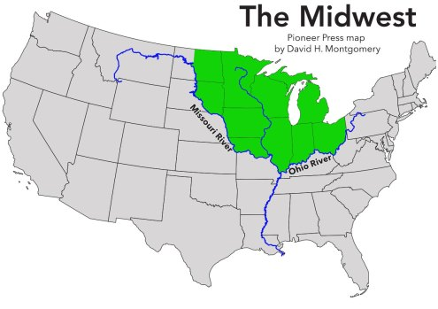
Filter – Choose Rows Matching Criteria
ohio <- midwest %>%
filter(state=="OH")
View(ohio)
ohioSmall <- midwest %>%
filter(state=="OH" & poptotal < 25000)
View(ohiosmall)
library(tidyverse)
midwest <- midwest
class(midwest)
glimpse(midwest)
View(midwest)
Only 1 character for AND

Slide 9

Select – Choose Columns by Name
Use : to list a range of columns
ohioethnicity_2 <- midwest %>%
filter(state=="OH" & poptotal < 25000) %>%
select(poptotal:popother)
View(ohioethnicity_2)
ohioethnicity <- midwest %>%
filter(state=="OH" &
poptotal < 25000) %>%
select(poptotal, popwhite, popblack, popamerindian, popasian, popother)
View(ohioethnicity)

Slide 10

Select – Choose Columns by Name
Use minus ( – ) to omit columns
ohioSmall_2 <- midwest %>%
filter(state=="OH" &
poptotal < 25000) %>%
select(-state)
View(ohiosmall_2)

Slide 11

Slice – Choose Rows Using Indexes
ohioethnicity_3 <- midwest %>%
slice(5, 7:11)
View(ohioethnicity_3)
lastEntry <- midwest %>%
slice((nrow(.)-1): nrow(.))
View(lastEntry)
Dot used in multiple places

Slide 12
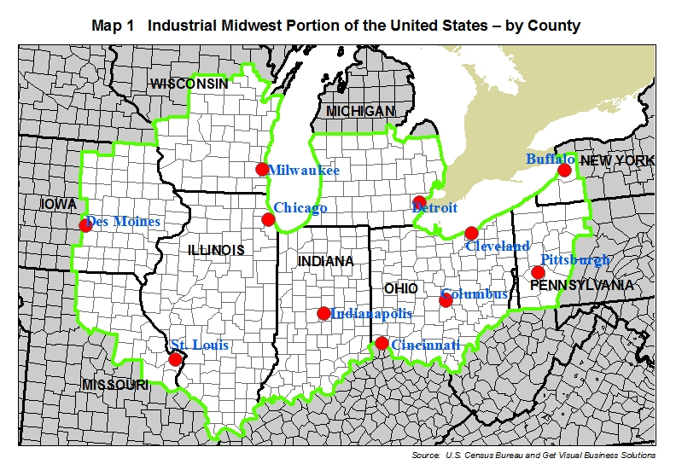
Count
numCounties <- midwest %>%
group_by(state) %>%
count(state)
View(numCounties)

Slide 13
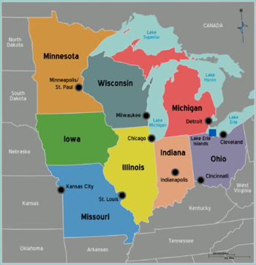
Distinct (Filters for Unique values) & Arrange (Ordering)
stateName <- midwest %>%
distinct(state) %>%
arrange(desc(state))
View(stateName)

Slide 14
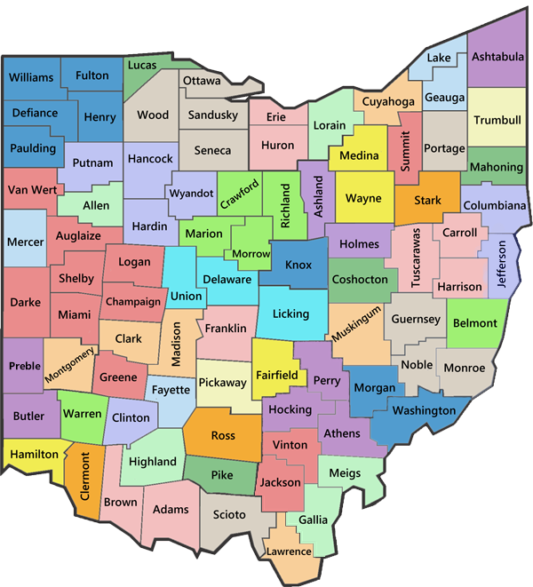
Summarize – Reduces Summary Statistics to 1 Value
ohiopopInfo <- midwest %>%
filter(state == "OH") %>%
summarize(popMean = mean(poptotal),
popWhiteMean = mean(popwhite),
popBlackMean = mean(popblack),
popAmerIndMean = mean(popamerindian),
popAsianMean = mean(popasian),
popOtherMean = mean(popother))
View(ohiopopInfo)

Slide 15
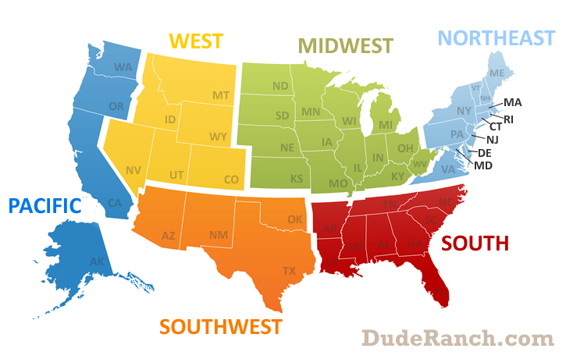
Summarize – Reduces Summary Statistics to 1 Value
popInfo <- midwest %>%
group_by(state) %>%
summarize(popMean = mean(poptotal),
popWhiteMean = mean(popwhite),
popBlackMean = mean(popblack),
popAmerIndMean = mean(popamerindian),
popAsianMean = mean(popasian),
popOtherMean = mean(popother))
View(popInfo)

Slide 16

Mutate – Creates a New Column
Use mutate instead of $ to add a column
ohiostats <- midwest %>%
filter(state == "OH") %>%
mutate(popwhitedensity = popwhite/area/1000,
popblackdensity = popblack/area/1000,
popamerindiandensity = popamerindian/area/1000,
popasiandensity = popasian/area/1000,
popotherdensity = popother/area/1000)

Slide 17
Mutate across
countyInfo_2 <- midwest %>%
group_by(state) %>%
select(state, poptotal, popdensity) %>%
mutate(across(.cols= everything(), list(mean,=mean sd=sd, n-distinct=n_distinct)))
distinct(state, poptotal_mean, popdensity_mean, popdensity_n_distinct) %>%
rename(mean_population = poptotal_mean,
mean_population_density = popdensity_mean,
number_of_counties = popdensity_n_distinct)
View(countyInfo_2)
Summary Statistics:
mean, sd, median, min, max, n_distinct
and more …
%>%

Slide 18
Mutate across
Can also use with a lambda function when needing to do the same action across many columns
  ~ tells R this is a lambda function
  .x refers to each column
num1 <- c(3, 9, -1, 14, 2)
num2 <- c(20, 70, -32, 116, 20)
df <- tibble(num1 = num1,
num2 = num2)
update_num <- df %>%
mutate(across(num1:num2, ~ .x / mean(.x)))

Slide 19
Separate – Divides a Column Into Several Columns
schools <- c("University of Mississippi, University, MS", "Mississippi State, Starkville, MS", "Southern, Hattiesburg, MS")
msSchools <- tibble(schools) %>%
separate(schools, c("School", "Location"), sep=",", extra = "merge") %>%
separate(Location, c("City", "State"), sep=",")
View(msSchools)

Slide 20
Mutate – Case When
countyInfo_2 <- midwest %>%
group_by(state) %>%
select(state, poptotal, popdensity) %>%
mutate(across(.cols= everything(), list(mean,=mean sd=sd, n-distinct=n_distinct)))
distinct(state, poptotal_mean, popdensity_mean, popdensity_n_distinct) %>%
rename(mean_population = poptotal_mean,
mean_population_density = popdensity_mean,
number_of_counties = popdensity_n_distinct)
mutate(properState = case_when(state == "IL" ~ "Illinois", state == "IN" ~ "Indiana", state == "MI" ~ "Michigan", state == "OH" ~ "Ohio", state == "WI" ~ "Wisconsin"))
View(countyInfo_2)
%>%
%>%

Slide 21
Case_When
case_when(logical test ~ value)
Must account for all possible values
  Data not found set to NA
studentData <- tibble( students = c("John", "Susie", "Joe", "Ryan", "Jane"),
grades = c("B", "A", "D", "F", "C"))
studentData <- studentData %>%
mutate(passFail = case_when(grades == "A" ~ "Pass“))
View(studentData)
All but A’s will list as NA

Slide 22
Case_When
case_when(logical test ~ value)
Must account for all possible values
  Data not found set to NA
studentData <- tibble( students = c("John", "Susie", "Joe", "Ryan", "Jane"),
grades = c("B", "A", "D", "F", "C"))
studentData <- studentData %>%
mutate(passFail = case_when(grades == "A" | grades == “B” | grades == “C” ~ "Pass",
TRUE ~ "Fail"))
View(studentData)
Only D and F are Failing

Slide 23
All states in midwest accounted for
mutate(properState = case_when(state == "IL" ~ "Illinois",
state == "IN" ~ "Indiana",
state == "MI" ~ "Michigan",
state == "OH" ~ "Ohio",
state == "WI" ~ "Wisconsin"))

Slide 24
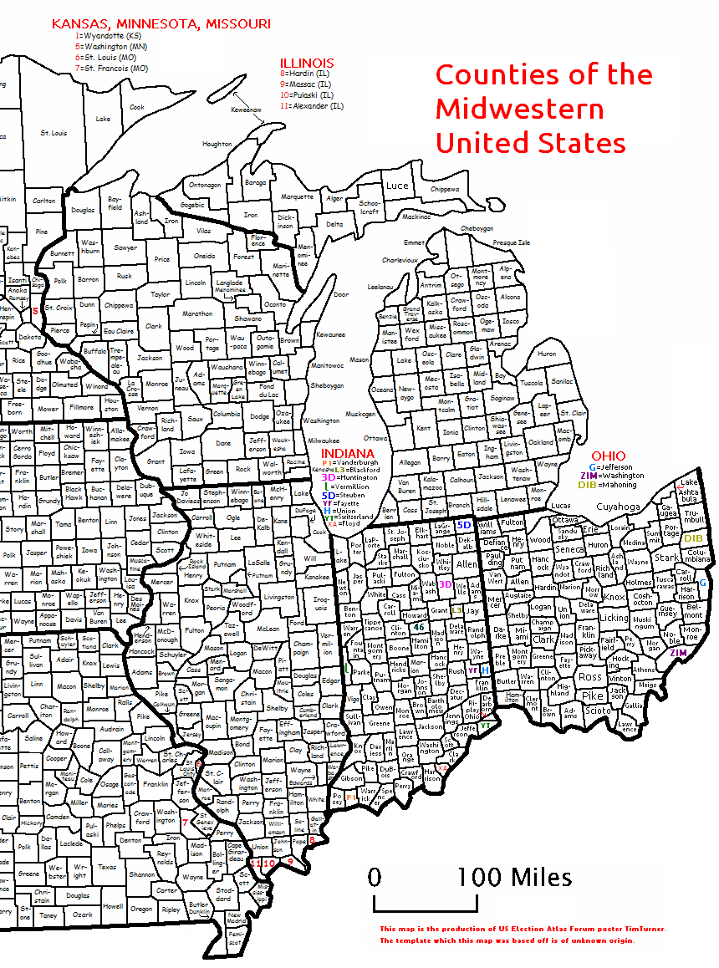
Sample_n – Randomly selects from a tibble
Randomly select 100 Midwestern counties:
state100 <- midwest %>%
sample_n(100)
View(state100)

Slide 25
Pull – Return a Column as a Vector
glimpse(midwest)
  How many observations?
popMean <- midwest %>%
summarize(popMean = mean(poptotal)) %>%
View(popMean)
belowMean <- midwest %>%
filter(poptotal < popMean)
View(belowMean)
How many observations in belowMean?
What is the issue as to why all observations listed?
  popMean is a tibble, not a vector
  Use pull to convert mean to a vector before determining the number below the mean
popMean <- midwest %>%
summarize(popMean = mean(poptotal)) %>%
pull()
View(popMean)
belowMean <- midwest %>%
filter(poptotal < popMean)
View(belowMean)

